Slide 1
Configuring sessions

Slide 2
Configuring sessions
Sessions are a common web application pattern that allows you to keep track of the user's behavior when they visit your application.
To add this functionality, you will need to install and configure the express-session middleware.

Slide 3
Configuring sessions (continued)
To do so, start by modifying your package.json file like this:
{
"name": "MEAN",
"version": "0.0.3",
"dependencies": {
"express": "~4.8.8",
"morgan": "~1.3.0",
"compression": "~1.0.11",
"body-parser": "~1.8.0",
"method-override": "~2.2.0",
"express-session": "~1.7.6",
"ejs": "~1.0.0"
}
}

Slide 4
Configuring sessions (continued)
Once the installation process is finished, you'll be able to configure your Express application to use the express-session module.
The express-session module will use a cookie-stored, signed identifier to identify the current user.
To sign the session identifier, it will use a secret string, which will help prevent malicious session tampering.
For security reasons, it is recommended that the cookie secret be different for each environment, which means this would be an appropriate place to use our environment configuration file.

Slide 5
Configuring sessions (continued)
To do so, change the config/env/development.js file to look like the following code snippet:
module.exports = {
sessionSecret: 'developmentSessionSecret'
};

Slide 6
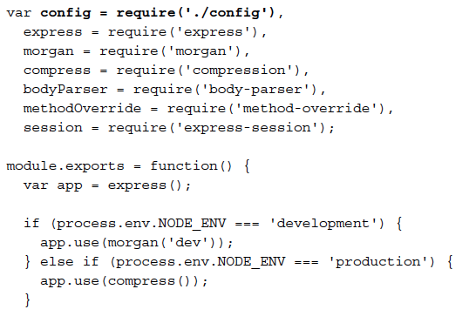
Configuring sessions (continued)
To use the configuration file and configure your Express application, go back to your config/express.js file and change it to look like the following code snippet:

Slide 7
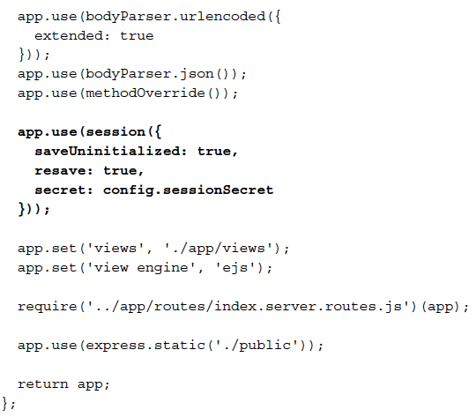
Configuring sessions (continued)
code snippet (continued):

Slide 8
Configuring sessions (continued)
Notice how the configuration object is passed to the express.session() middleware.
In this configuration object, the secret property is defined using the configuration file you previously modified.
The session middleware adds a session object to all request objects in your application.
Using this session object, you can set or get any property that you wish to use in the current session.

Slide 9
Configuring sessions (continued)
To test the session, change the app/controller/index.server.controller.js file as follows:
exports.render = function(req, res) {
if (req.session.lastVisit) {
console.log(req.session.lastVisit);
}
req.session.lastVisit = new Date();
res.render('index', {
title: 'Hello World'
});
};
What you did here is basically record the time of the last user request.
The controller checks whether the lastVisit property was set in the session object, and if so, outputs the last visit date to the console.
It then sets the lastVisit property to the current time.

